Slide 1
Engineering Innovation Get and Discover
By - Johnny Li

Slide 2
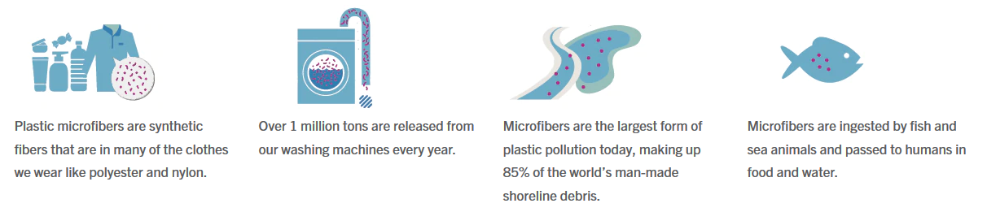
Background
Source Image: [1]
A subcategory of microplastics is microfibers, which constitute 35% of all microplastic pollution. [2]
These microfibers are mostly coming from our clothes. Of all the world's fiber production, 60% of it is synthetic, meaning made from a plastic material. Every time you wash your clothes or sheets, the fabrics release microfibers. [2]
These microfibers travel from the washing machine drains to headwater streams, rivers, lakes, and ocean water.
A study finds more than 100 microfibers in an individual fish. Widespread exposure raises concerns about the effects on wildlife and human health. [3]
Microplastics have long been known to damage lung tissue, leading to cancer, asthma attacks, and other health problems. [4]

Slide 3
Unmet Need
A way to prevent plastic microfibers, washed off from synthetic clothes and textiles, from being released to the ocean.

Slide 4
Discovery Process
Networking - This topic was initially introduced through a guest lecture in an environmental science course at UF. The guest lecture was an expert in the field of oceanic pollution and discussed the negative impacts of plastic getting into the ocean.
Afterward, I started to research the origin of the problem and its effects on human health as a write-up assignment for the course.
Observing – The topic was narrowed to microplastics through listening to a news podcast on its impact on planktons in the ocean. [5]
Association – During my time shopping after the introduction of this problem, I was questioning how a polyester shirt in the store contributed to the oceanic pollution. When thinking about the product lifecycle of the shirt, I realize that the shirt will likely end up in a landfill but the continuous washing of it would be a factor of the pollution.
I found that microfibers are a critical problem for the oceanic environment that originates from the use of washing machines.

Slide 5
Stakeholder Analysis
List of stakeholders
Oceanic Industries: Mariners, fishermen, seafood suppliers, and subsistence users who make their livelihood on fishing.
Oceanic scientists and researchers.
Landowners: the land the people own has access to the ocean.
Government/Resource managers/Policymakers seeking ways to use and sustain resources for the future.
Citizens: Public consumers of seafood or users of synthetic clothing.
Doctors and health officials.
Conservationist/Environmental activist groups.
Clothing manufacturers.
Clothing sellers.
Washing machine manufacturers.
Washing machine sellers.
Economist.
Journalist.

Slide 6
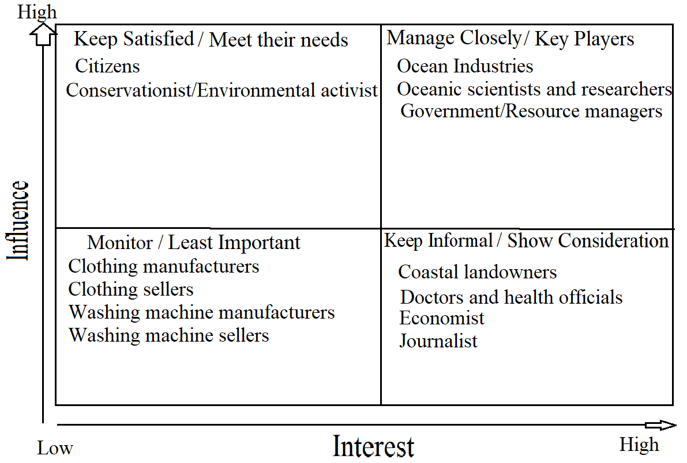
Stakeholder Mapping

Slide 7
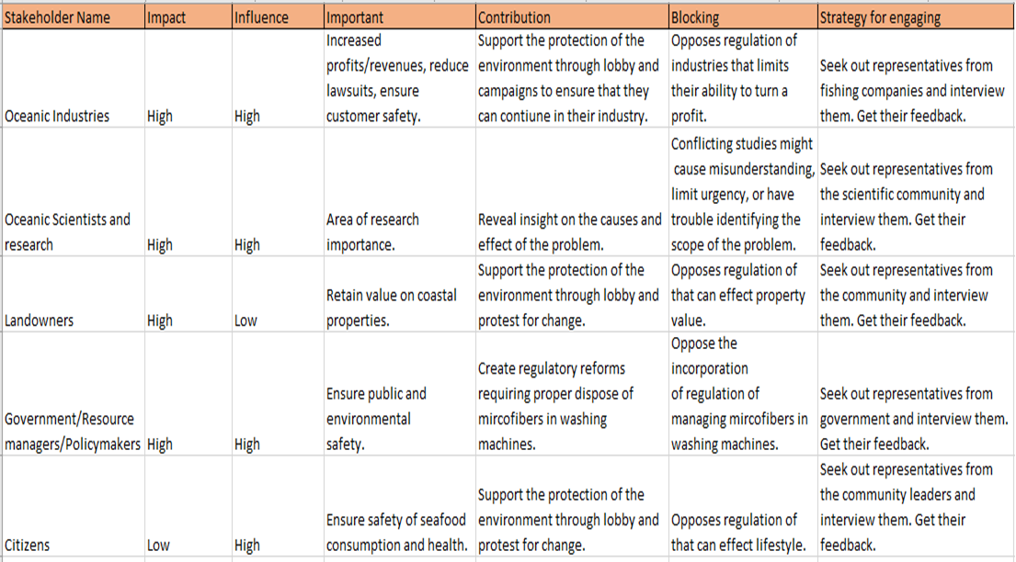
Stakeholder Matrix

Slide 8
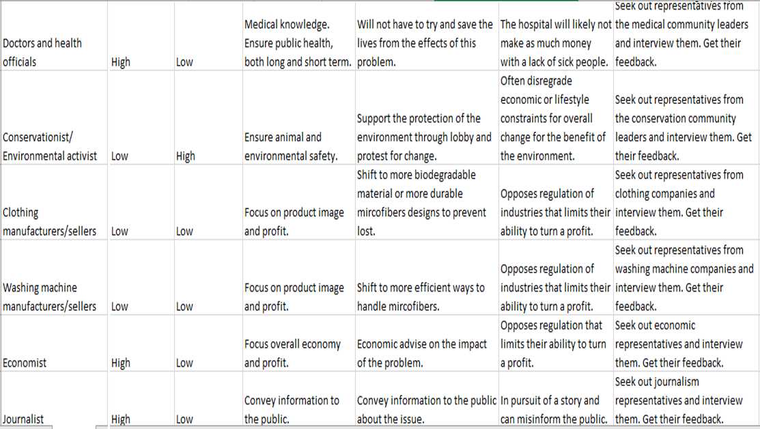

Slide 9
Stakeholder Interviews
Interview 3 stakeholder groups:
1. Interviewed 4 Conservationist/Environmental activist
Students from various environmental club.
2 Male, 2 Female, age range 18-23.
2. Interviewed 2 Oceanic Scientists and Researchers
One professor and one graduate student researcher.
1 Male, 1 Female, experiences 10+ years and 4+ years respectively.
3. Interviewed 4 avid Fisherman.
3 Male, 1 Female fishing experience of 4-25years.

Slide 10
Key Findings
Conservationist/Environmental activist
Mix understanding and varying knowledge of the causes and effects of microfibers.
Mainly have natural material clothing.
Innovative change needs to be affordable and simple to implemented, should not disrupt current method of doing things.
May spend more on products to be eco-friendly, within reason.
Clothing material would likely not change and is more based on current fashion trends.
Believe industry/market should promote change and spread information of the issue to the public.
A negative perspective to the microfiber pollution in the ocean.
Oceanic Scientists and Researchers
Current limits of handling microfibers in domestic washing machines and waste treatment plants, too small to filter out.
Lead to microfibers flowing to the ocean and eaten by microorganism -> up the food chain. To human by consumption.
Seek universal adoption of regulations to prevent microfibers.

Slide 11
Currently, putting the cost of filtering onto the consumer by third-party products.
Lack of evidence of harmful effects on humans.
Goal isn’t about placing blame or cost on any group by a call for global action.
Regulations can prevent harm to people and the environment through reduction of pollution.
There is a lack of standards to prevent microfibers in the US.
Fisherman
Effect of microfiber pollution can go unnoticed.
Businesses may see certain environmental laws in a negative light if they must adapt their practices and increase spending to comply with regulations.
Environmental laws that impose regulations without considering their impacts on local communities come with a serious disadvantage: lack of local support.
Regulations protects consumers even when this means less super normal profits for businesses with market power.
Regulation ensure future generation can also enjoy the wildlife and environment.

Slide 12
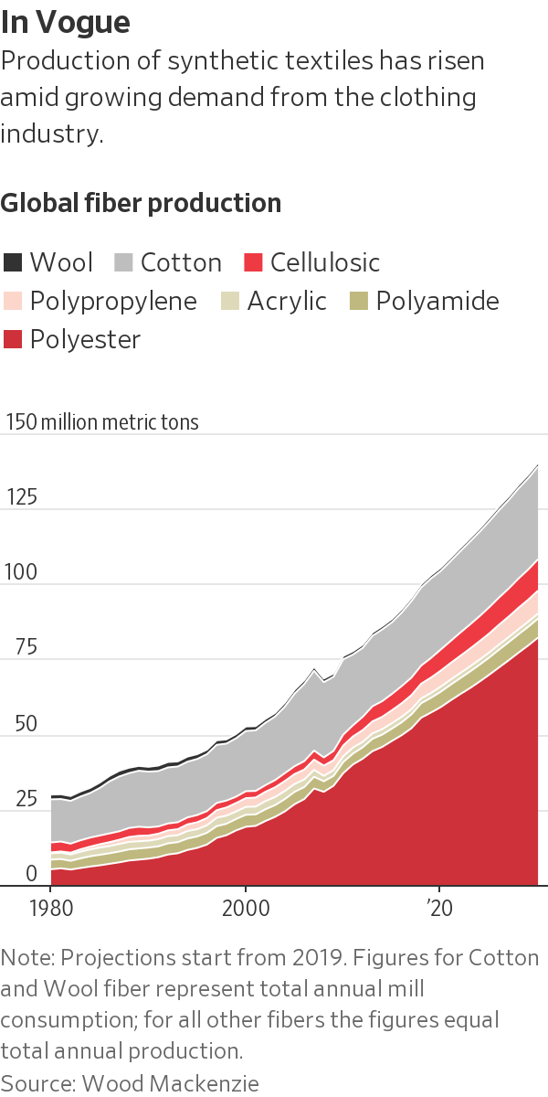
market research
Currently, there is a lack of standards and laws surrounding the disposal of microfibers.
No national laws and varying degree of state laws ranging from none to consumer education. [7]
Globally, there is no concise standards with each country dealing with microfiber pollution in their own way.
There is a rise in the sale of synthetic fabrics is recent years since they are cheaper, more durable, and often more comfortable than natural fabrics.
With that, more people are becoming aware of the problem and are willing to take steps to reduce their impact of producing microfibers.

Slide 13
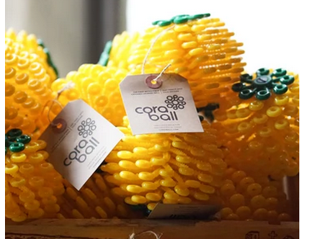
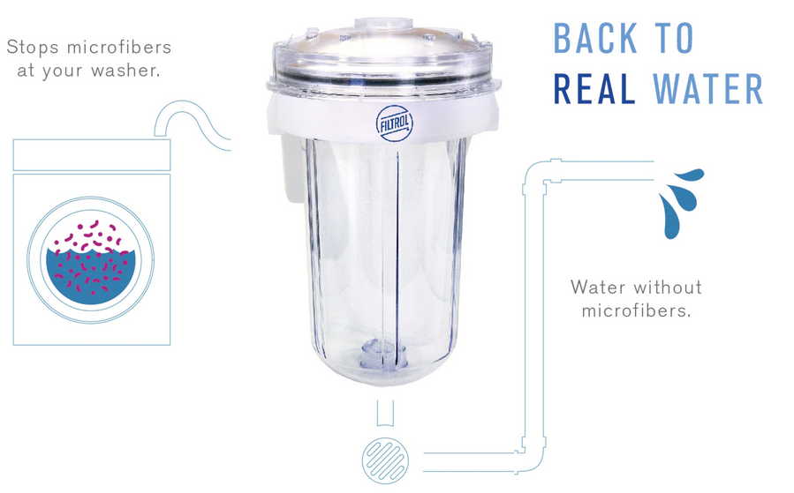
There are various types of solution already out in the market:
Internal (inside the washing machine) solutions that catches the microfiber released in the washing cycle.
Tends to be the easiest and low maintenance items, just toss it
in and clean it afterward. Very cheap and portable.
However, they are ineffective ,catches around 25% of the
microfibers, compared to external solutions, around 80%.
External (filter attached outside the washing machine) solutions filter out the waste water from the machine for microfibers before it goes to the drain.
These tend to require more room to place the attachment onto washing machines and a bit of handiwork to setup.
After filling up, they are to be disposed or sent back to manufacture for processing.
More expensive and relatively fixed to a single location.

Slide 14
Market share of competitors in this niche area is unavailable.
Total Addressable Market:
Can be promoted as an safety device for wash machines.
Seek to standardize the filter to require it to be installed in all washing machines and water treatment plants.
Serviceable Addressable Market:
Can be sold to all washing machine manufactures or general owners of washing machines.
Target Market:
Focus on people concern about the environment, activist or enthusiast, are those who are willing spend money on attachment to the washing machine to make it ecofriendly.

Slide 15
Market Segments:
Stakeholder Needs – Some customers want a product to prevent microfibers, released during washing machine cycle, from being drained out.
Stakeholder Preferences – The customers wants a product to be affordable and simple to implemented, should not disrupt current method of doing things.
Lifestyle - The customers prefer not to disrupt current lifestyle of washing clothes or the adjustments should make the process easier.
Culture – Customers with conservationist or environmental focus.
Type – Consumers
Income – Range from middle to high income.
Price Sensitivity – Customers want a cheap product that will last a long time.
Value - Stakeholders who seek to minimize the environmental impact of their purchase.
Channels – Retail customers
Readiness – Learning curve messages geared to early adopters
Knowledge – A line of product that clearly promote the cause without the need of detailed information.

Slide 16
Personnel
My Skills
Lots of experience in designing, testing, and the analysis of collected data.
I am extremely open to other’s opinions and viewpoints to make this product a success.
Software Developer – someone who could help develop an app-based system.
Hardware Developer – someone who could help develop an device-based system.
What I am looking for?
Environmental scientist to research how effective our product can be.
Help with brainstorming and figuring out ways to reduce costs.
Designers to help with modeling filters or devices.
People with a strong knowledge of the clothing fabrics and the mechanism of a washing machine.

Slide 17
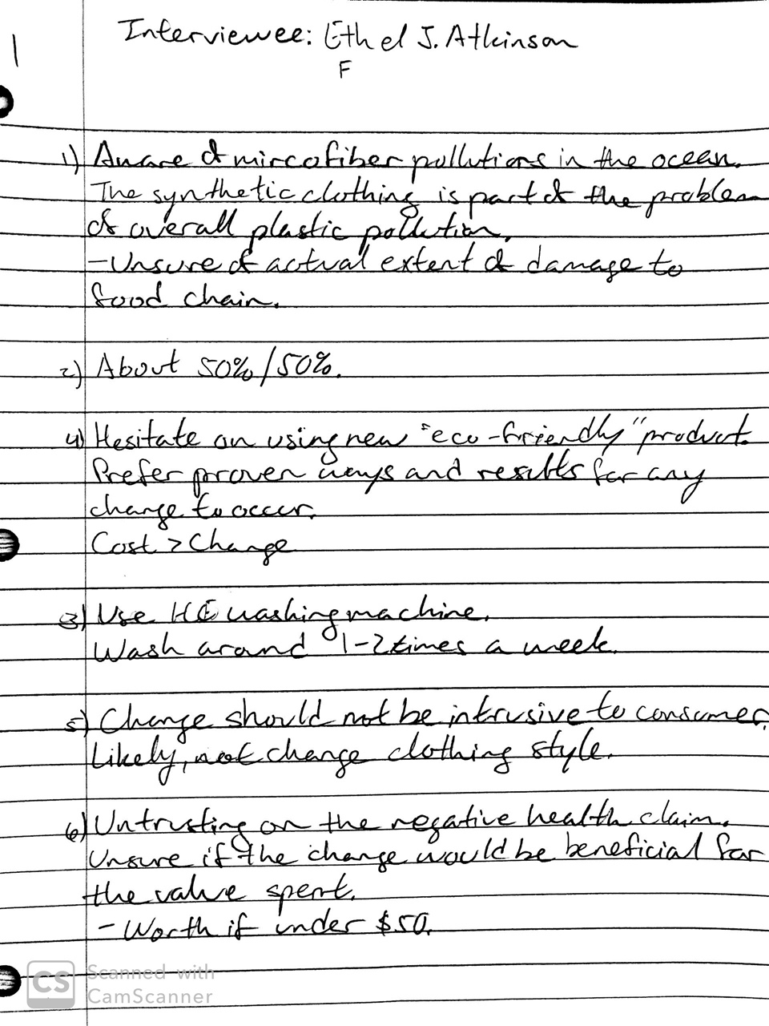
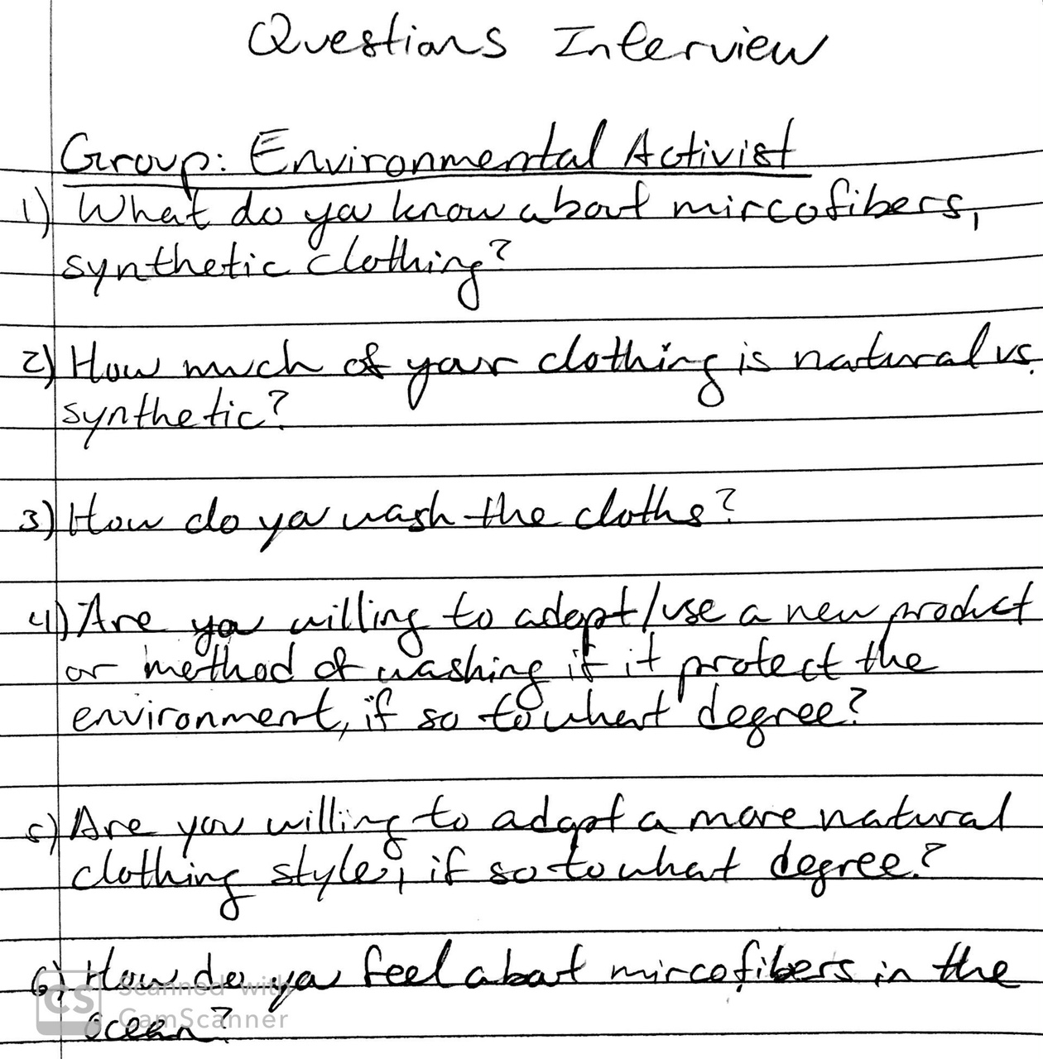
Appendix

Slide 18
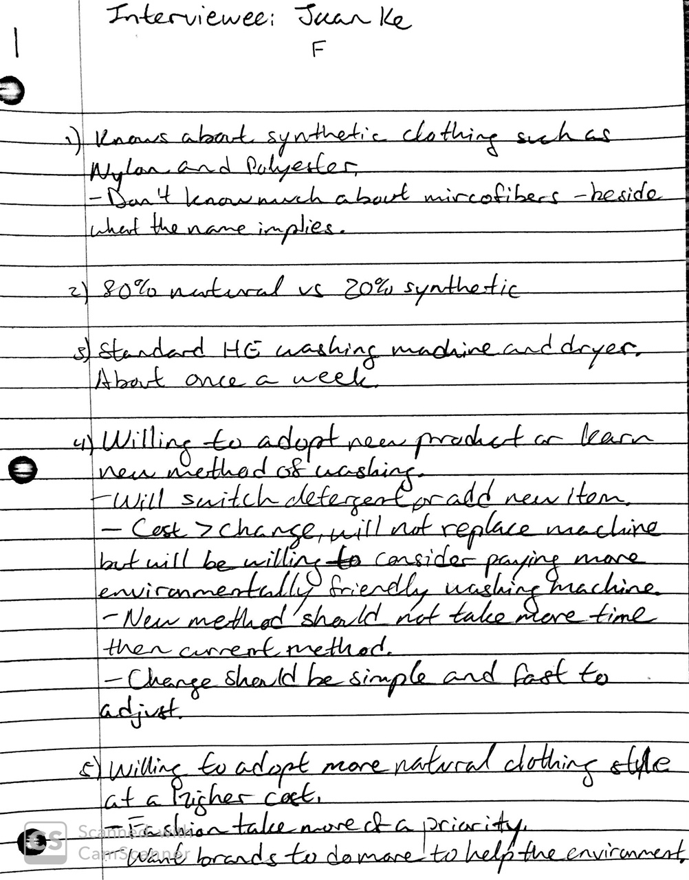
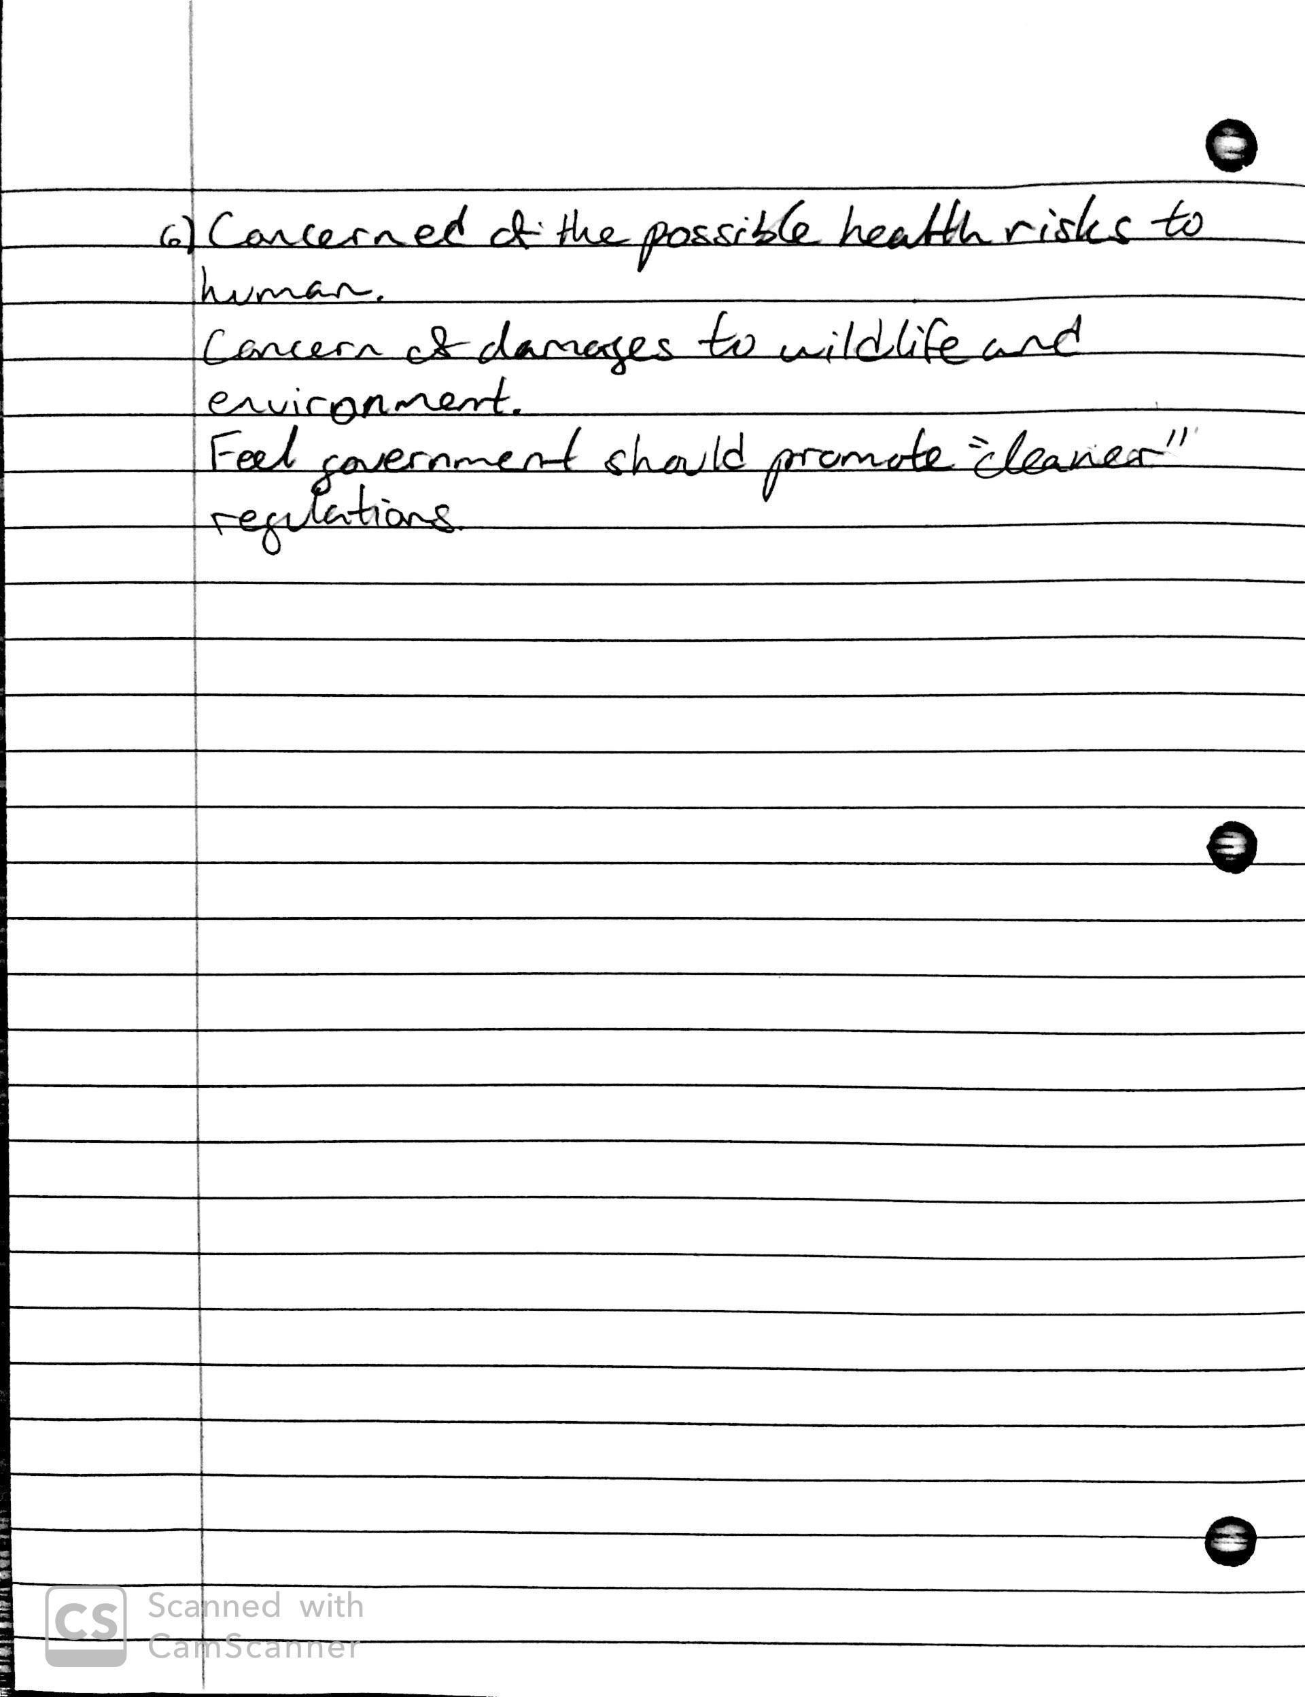

Slide 19
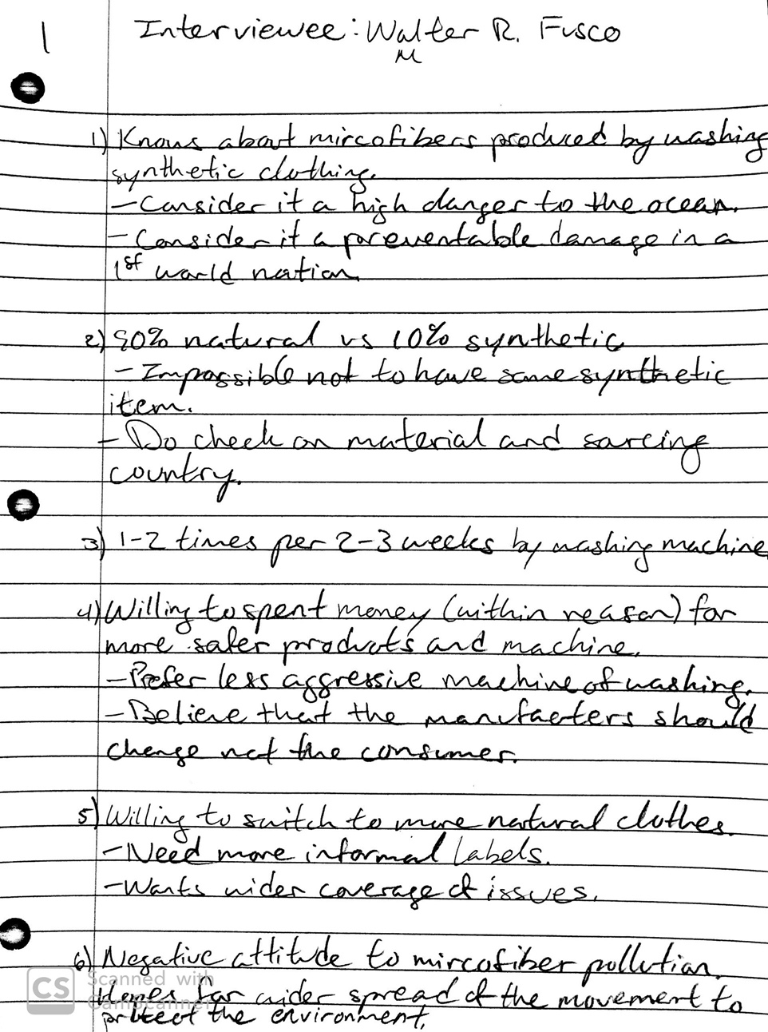
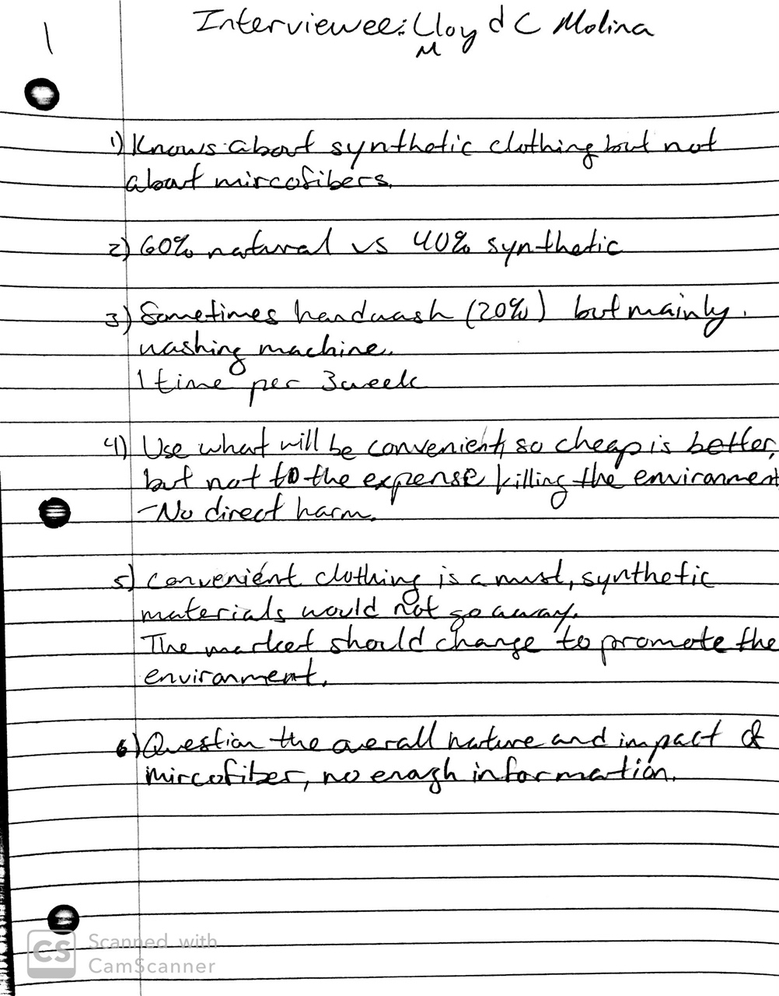

Slide 20
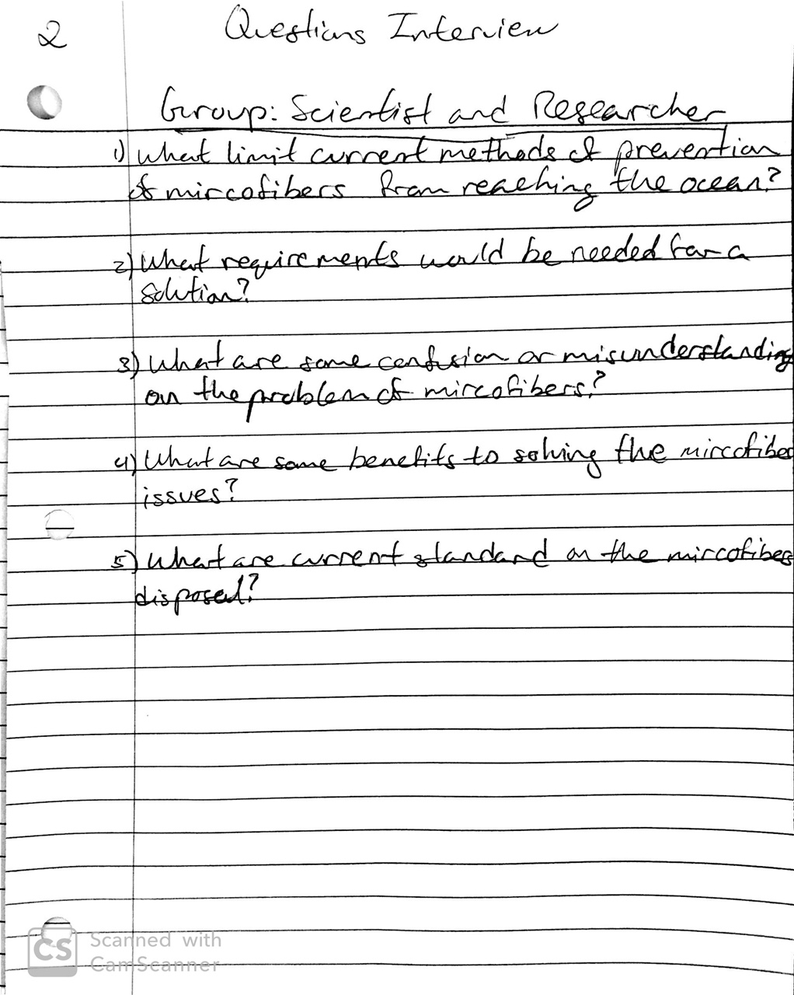
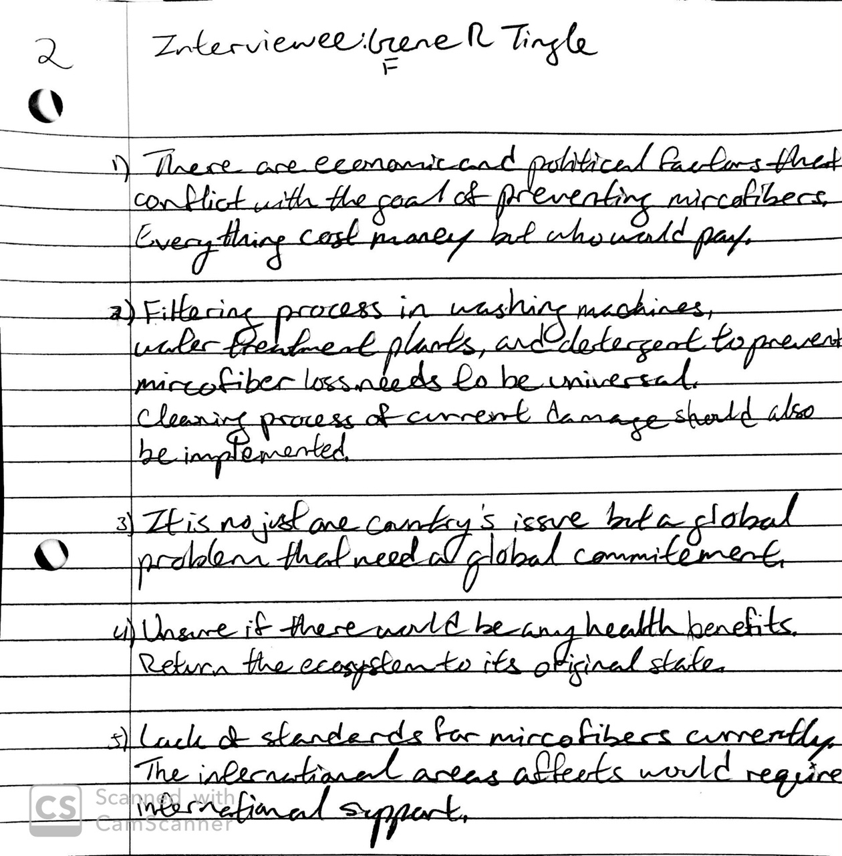

Slide 21
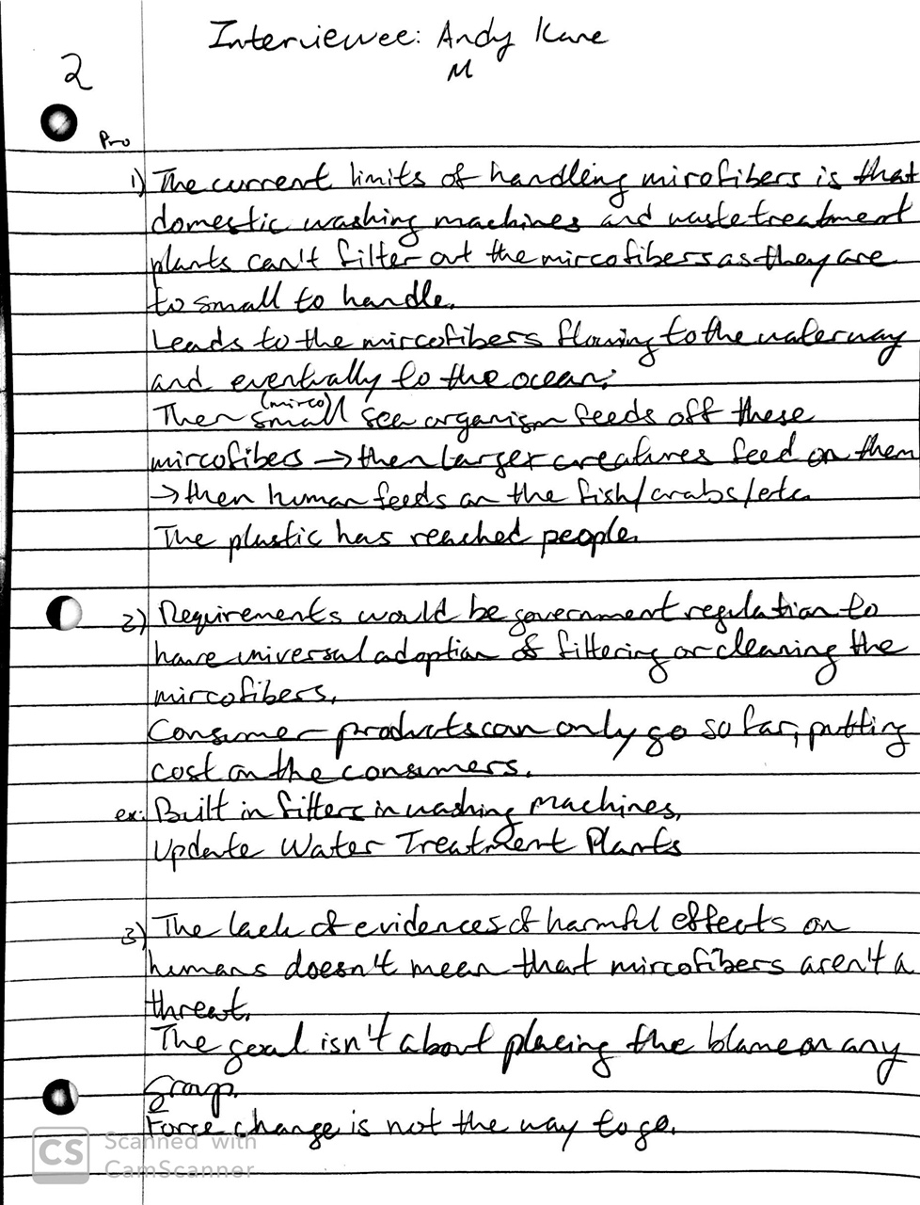
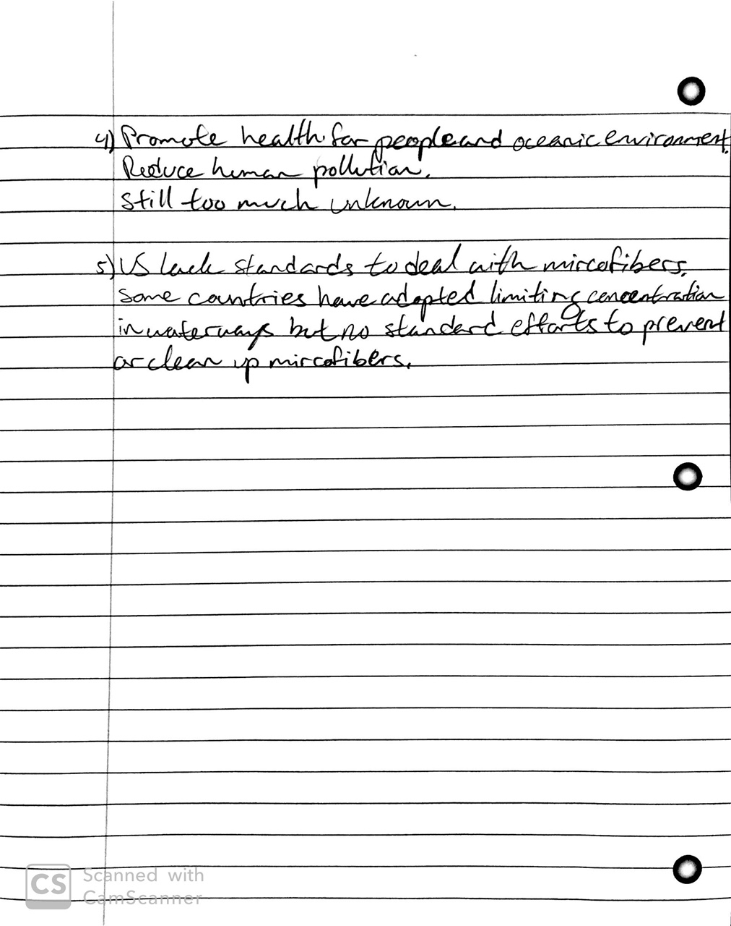

Slide 22
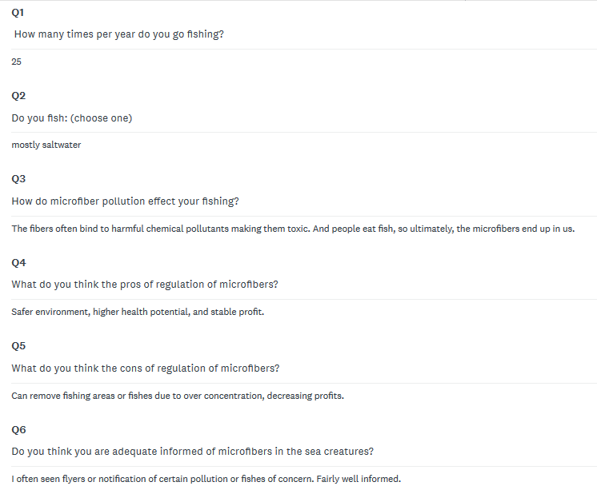
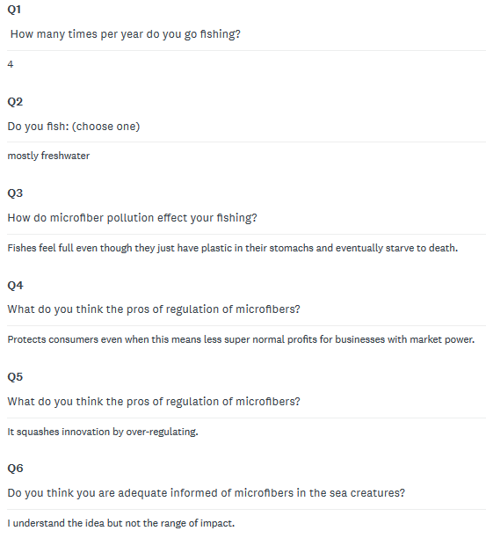

Slide 23
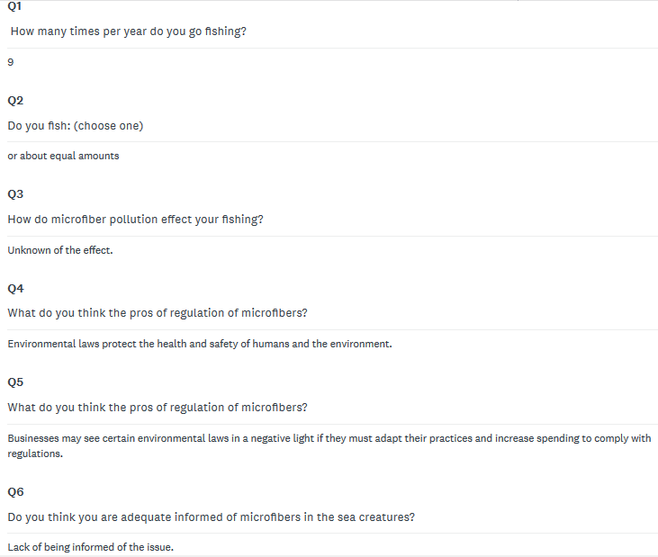
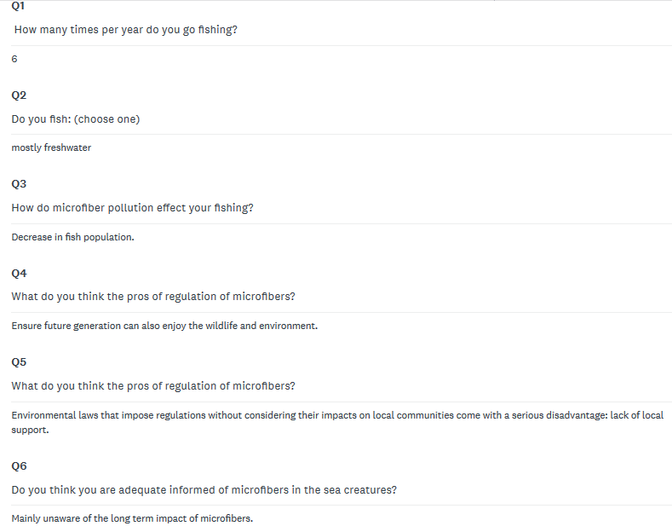

Slide 24
References
1. “New Home.” The Filtrol | Washing Machine Microfiber and Lint Filter | Stop Plastic Microfiber Pollution, filtrol.net/.
2. Andrea d. Steffen. “This Is The First Ever Microplastics Filter For Washing Machines!” Intelligent Living, NPR, 12 Sept. 2019, www.intelligentliving.co/microplastics-filter-washing-machines/.
3. Kart, J. (2020). Science Says Laundry Balls And Filters Are Effective In Keeping Microfibers Out Of Waterways. [online] Forbes.com. Available at: https://www.forbes.com/sites/jeffkart/2019/02/01/science-says-laundry-balls-and-filters-are-effective-in-removing-microfibers/#5b17b9bce07a [Accessed 2 Feb. 2020].
4. “What Is Microfibers Pollution and Why Is It Bad?” Ocean Clean Wash, www.oceancleanwash.org/the-issue/.
5. Why These Plankton Are Eating Plastic, Vox, 25 Feb. 2019, www.youtube.com/watch?v=beUhzQAkanM.
6. Survey: https://www.surveymonkey.com/r/JRPWRKF
7. “Bills and Best Practices for Microfiber Pollution Solutions.” Surfrider Foundation, www.surfrider.org/coastal-blog/entry/bills-and-best-practices-for-microfiber-pollution-solutions.

